Slide 1

Analyzing President Trump’s Tweets labeled by Twitter
CS895 - Web Archiving Forensics, Fall 2020
Old Dominion University
Department of Computer Science
Kritika Garg, kgarg001@odu.edu
@kritika_garg (kgarg001@odu.edu) CS895 Web Archiving Forensics, Fall 2020

Slide 2
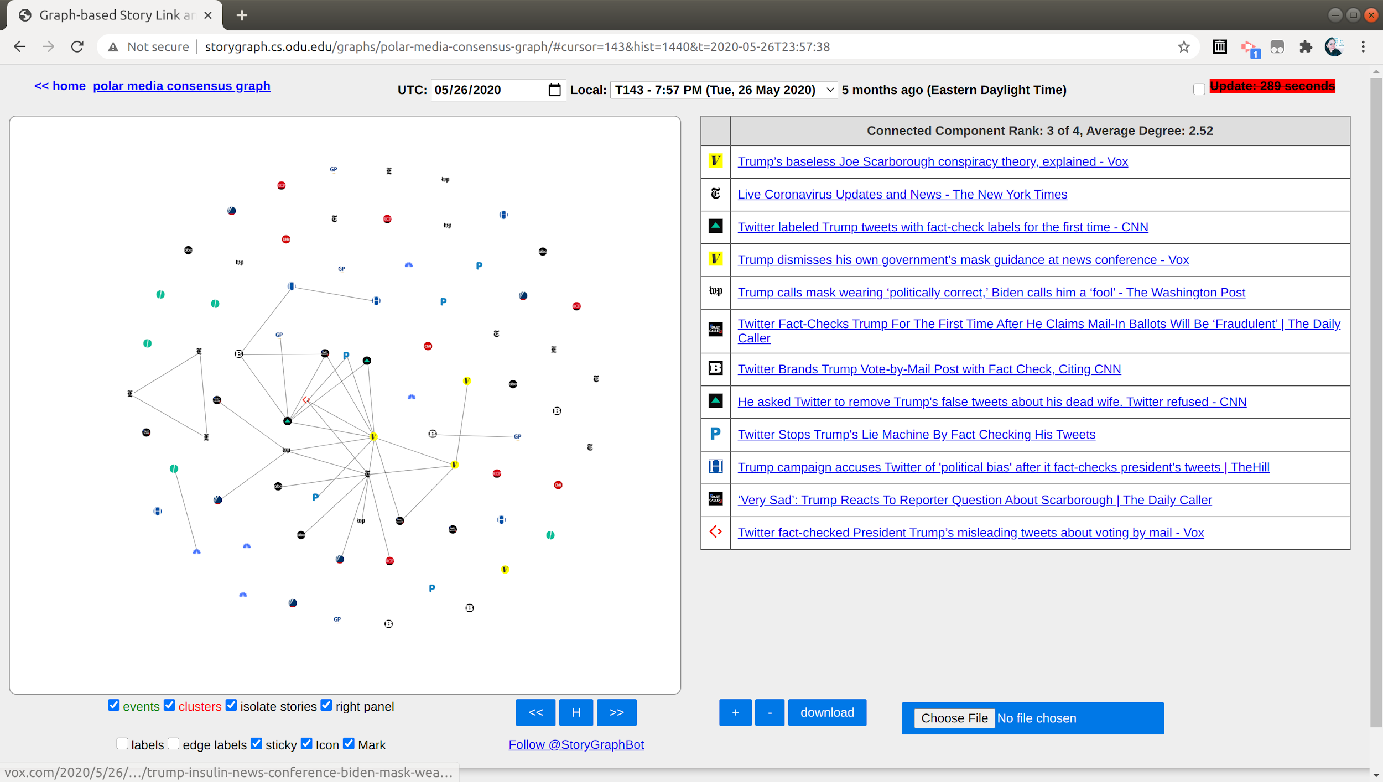
President Trump’s tweet was first labeled by Twitter on May 26, 2020.
http://storygraph.cs.odu.edu/graphs/polar-media-consensus-graph/#cursor=143&hist=1440&t=2020-05-26T23:57:38
@kritika_garg (kgarg001@odu.edu) CS895 Web Archiving Forensics, Fall 2020

Slide 3
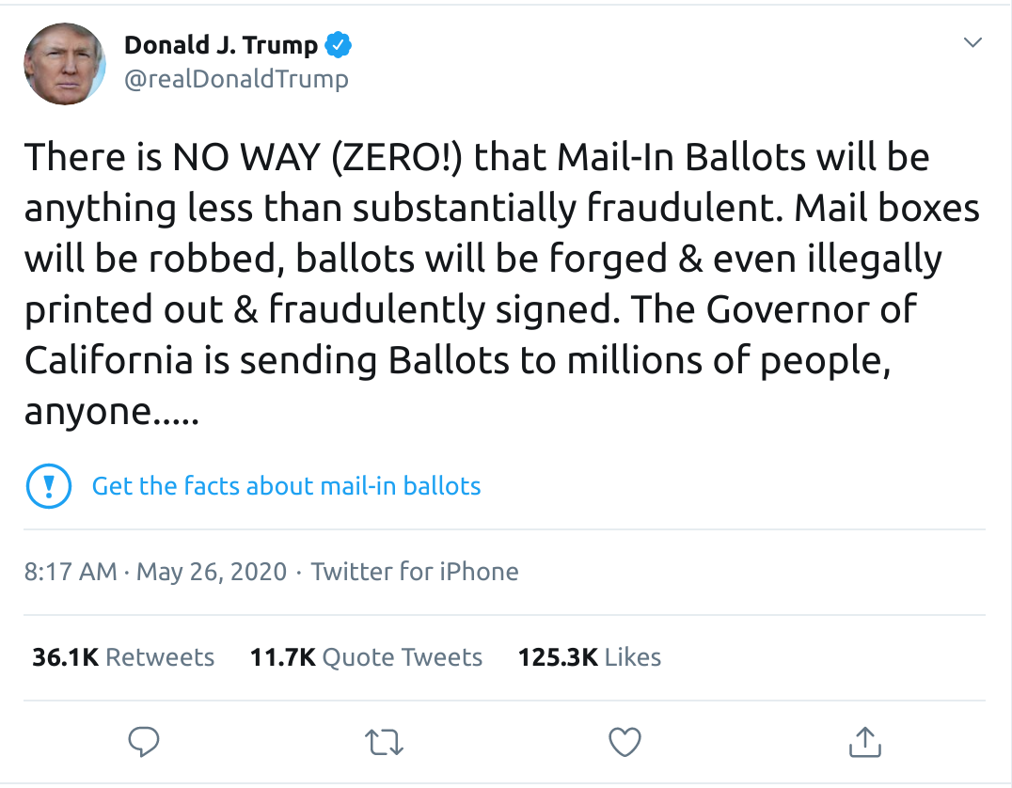
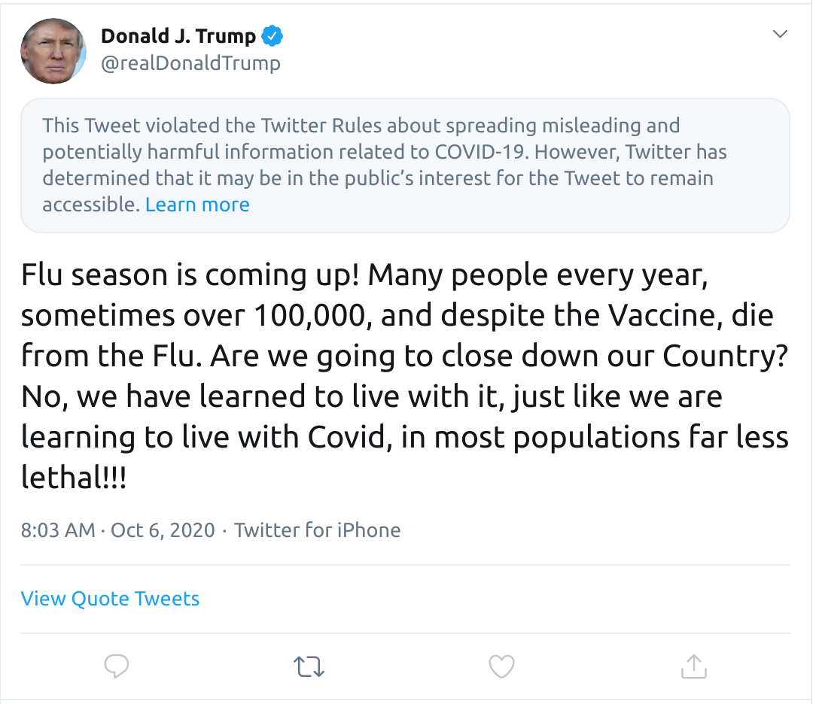
Two Types Of Labels
Fact-check Labels
Violated Twitter Rules Labels
https://twitter.com/realDonaldTrump/status/1265255835124539392
https://twitter.com/realDonaldTrump/status/1313449844413992961
@kritika_garg (kgarg001@odu.edu) CS895 Web Archiving Forensics, Fall 2020

Slide 4
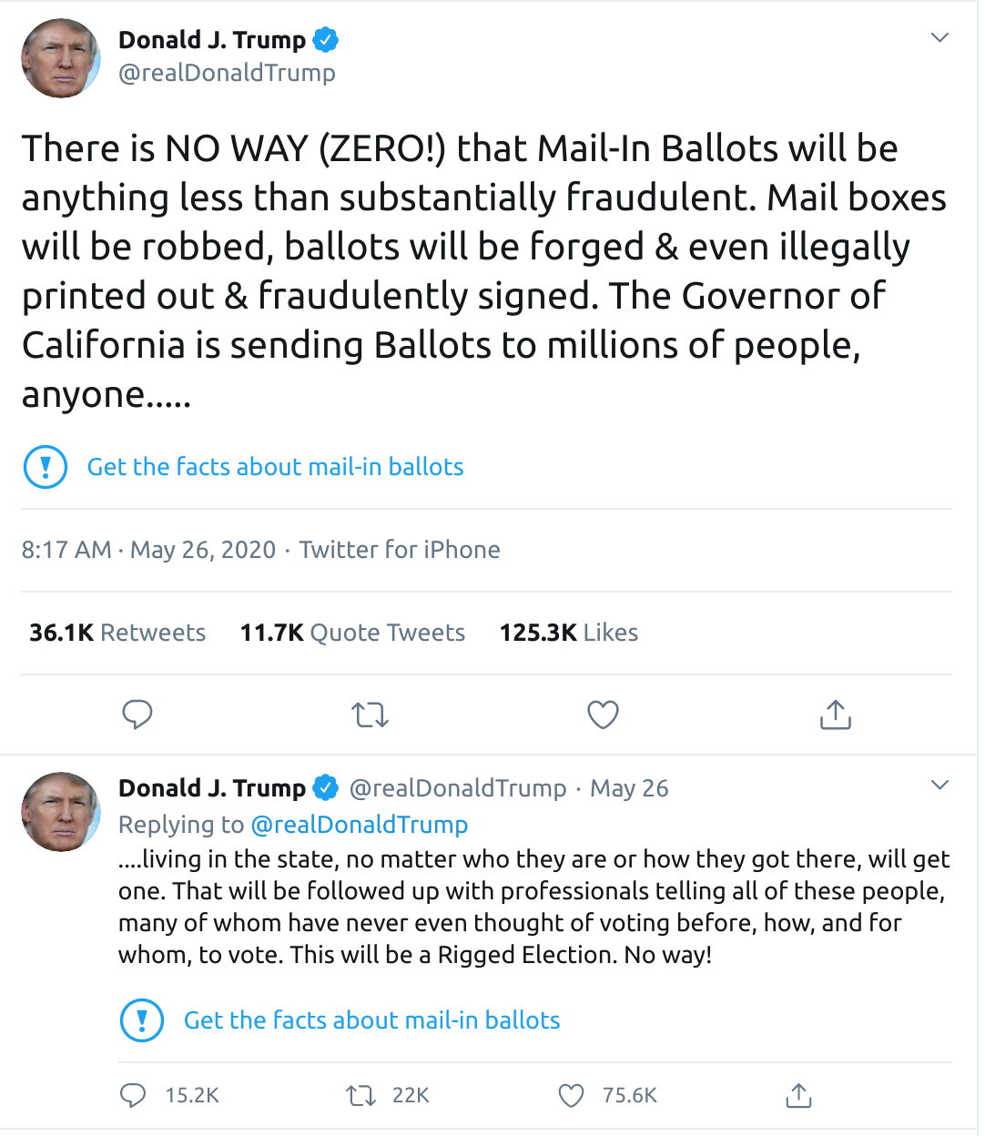
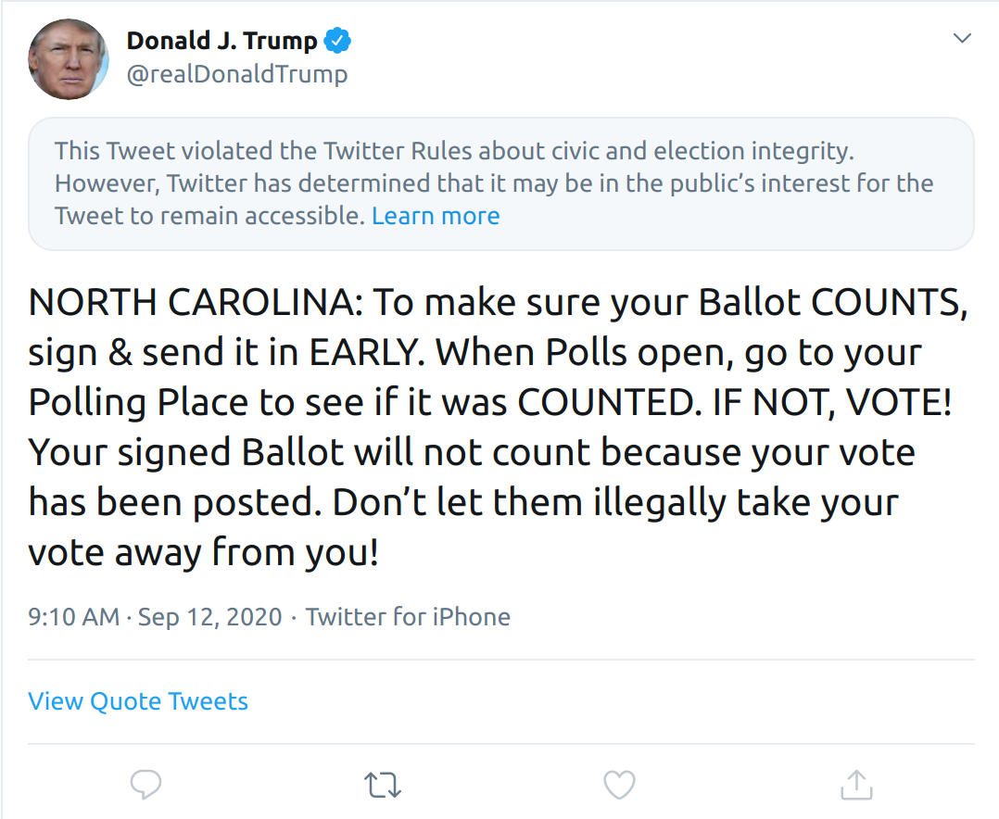
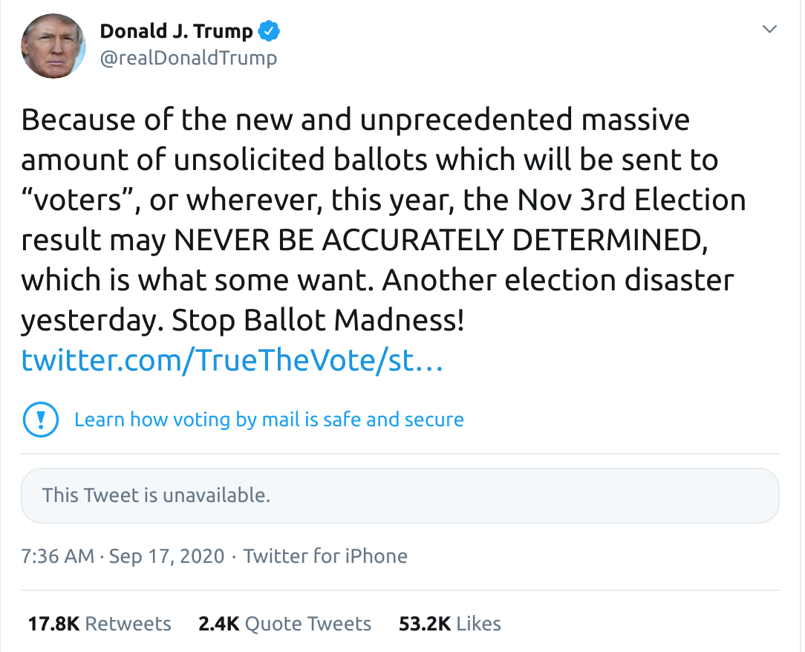
10 Tweets have been labeled so far
Tweet IDs
1313449844413992961
1306557587375128576
1304769412759724033
1301528521752354816
1301528522582786049
1297495295266357248
1275409656488382465
1266231100780744704
1265255835124539392
1265255845358645254
@kritika_garg (kgarg001@odu.edu) CS895 Web Archiving Forensics, Fall 2020
Notes:
be sure to include URI-Rs, URI-Ms, etc. in your repo

Slide 5
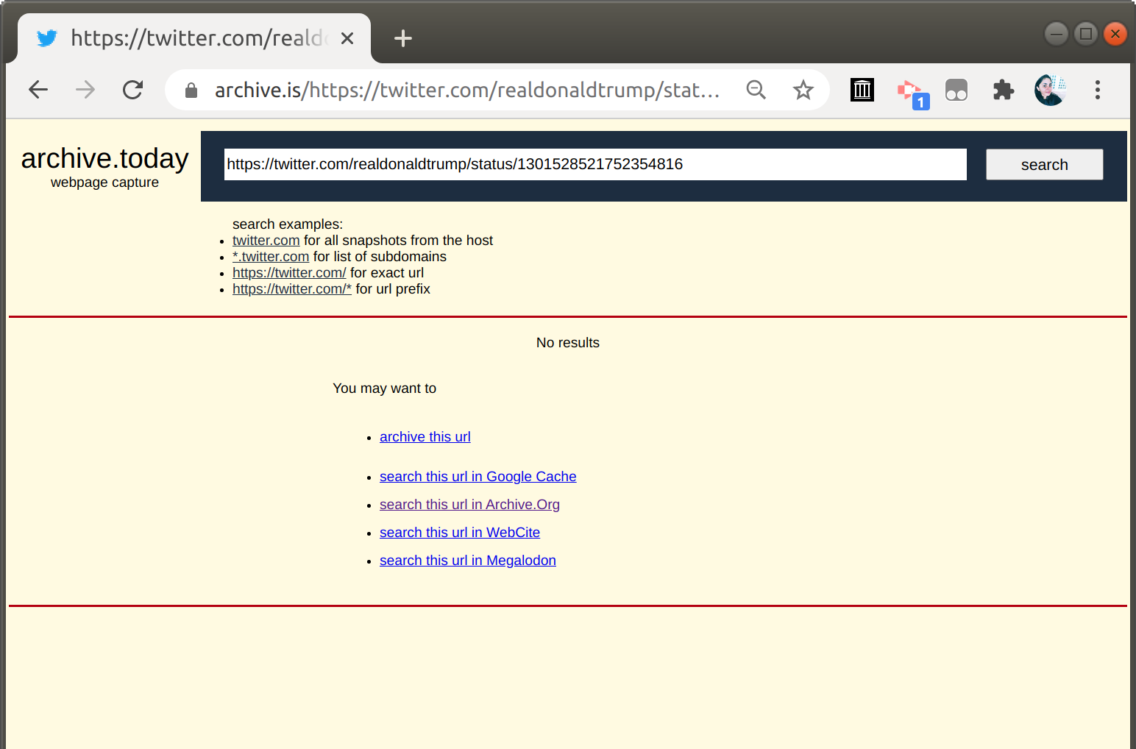
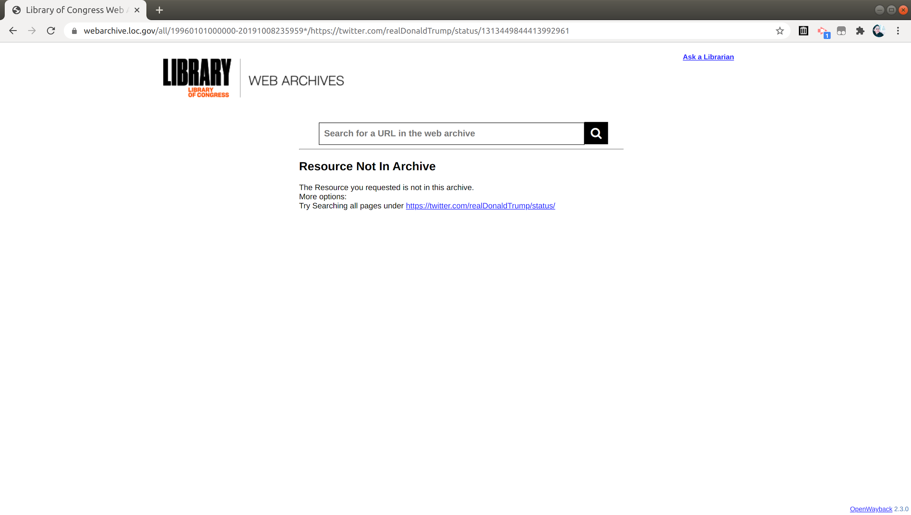
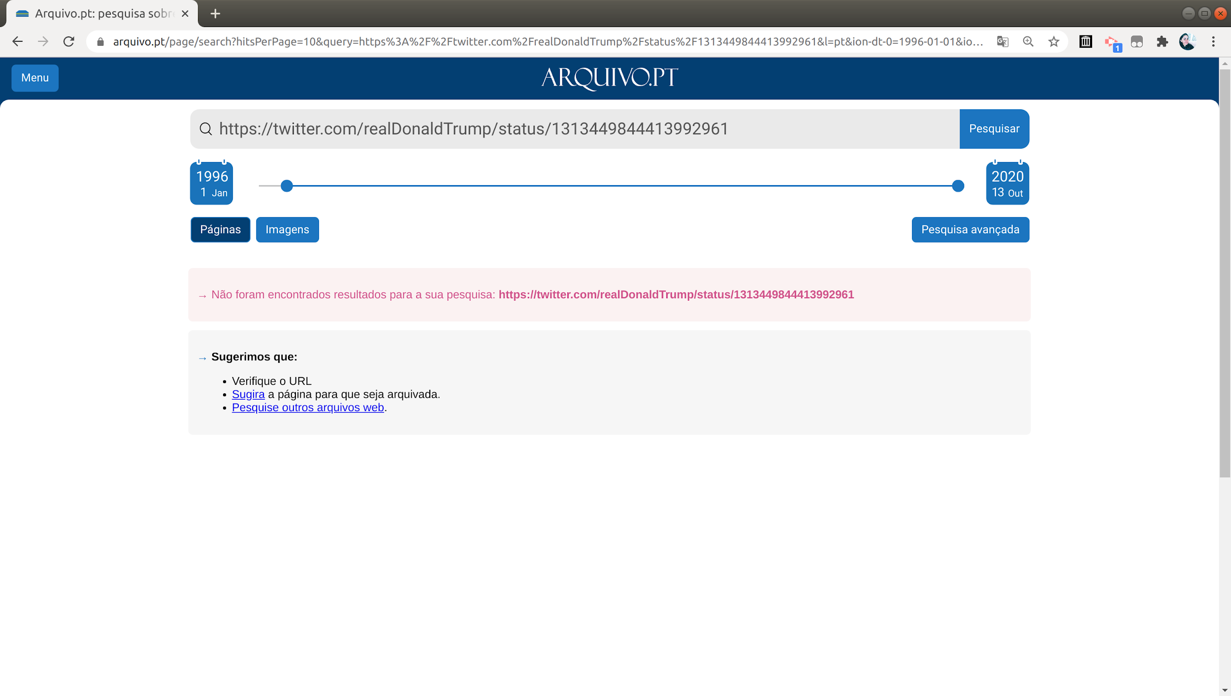
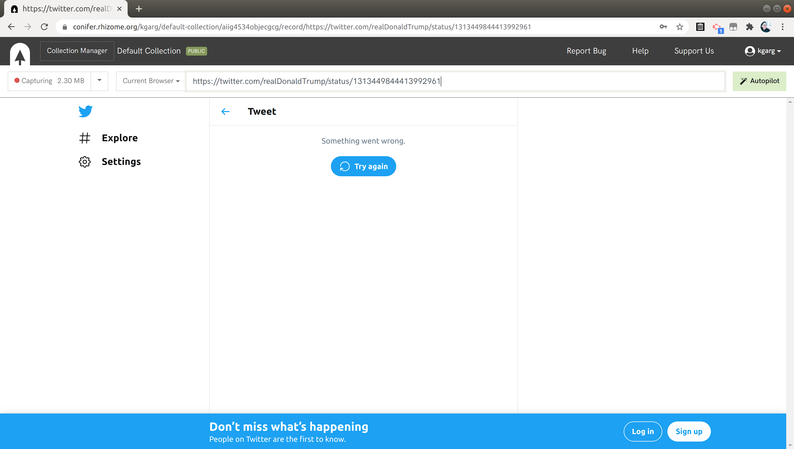
These Tweets are mostly archived in IA.
$ curl -s http://memgator.cs.odu.edu/timemap/link/https://twitter.com/realDonaldTrump/status/1313449844413992961 | grep datetime | awk -v FS=/ '{print $3}' | sort | uniq -c | sort -n
84 web.archive.org
$ curl -s http://memgator.cs.odu.edu/timemap/link/https://twitter.com/realDonaldTrump/status/1275409656488382465 | grep datetime | awk -v FS=/ '{print $3}' | sort | uniq -c | sort -n
4 archive.md
161 web.archive.org
$ curl -s http://memgator.cs.odu.edu/timemap/link/https://twitter.com/realDonaldTrump/status/1266231100780744704 | grep datetime | awk -v FS=/ '{print $3}' | sort | uniq -c | sort -n
4 perma.cc
16 wayback.archive-it.org
36 archive.md
748 web.archive.org
@kritika_garg (kgarg001@odu.edu) CS895 Web Archiving Forensics, Fall 2020

Slide 6
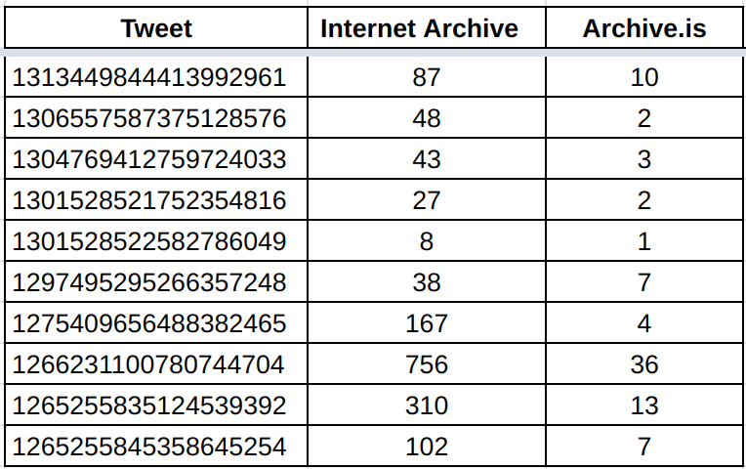
How well are these tweets archived?
Table 1. The number of mementos in IA and Archive.is for the 10 labeled tweets.
Data is tabulated using Memgator & CDX API on 2020-10-14T21:45.
https://github.com/oduwsdl/MemGator,
https://github.com/internetarchive/wayback/blob/master/wayback-cdx-server/README.md
@kritika_garg (kgarg001@odu.edu) CS895 Web Archiving Forensics, Fall 2020

Slide 7
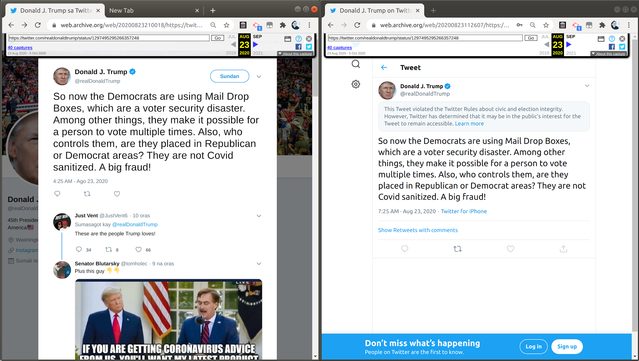
Old UI and new UI mementos in IA
https://web.archive.org/web/20200823210018/https://twitter.com/realdonaldtrump/status/1297495295266357248
https://web.archive.org/web/20200823112607/https://twitter.com/realdonaldtrump/status/1297495295266357248
WSDL Blog describing this change in detail: https://ws-dl.blogspot.com/2020/07/2020-07-15-twitter-was-already.html
@kritika_garg (kgarg001@odu.edu) CS895 Web Archiving Forensics, Fall 2020

Slide 8
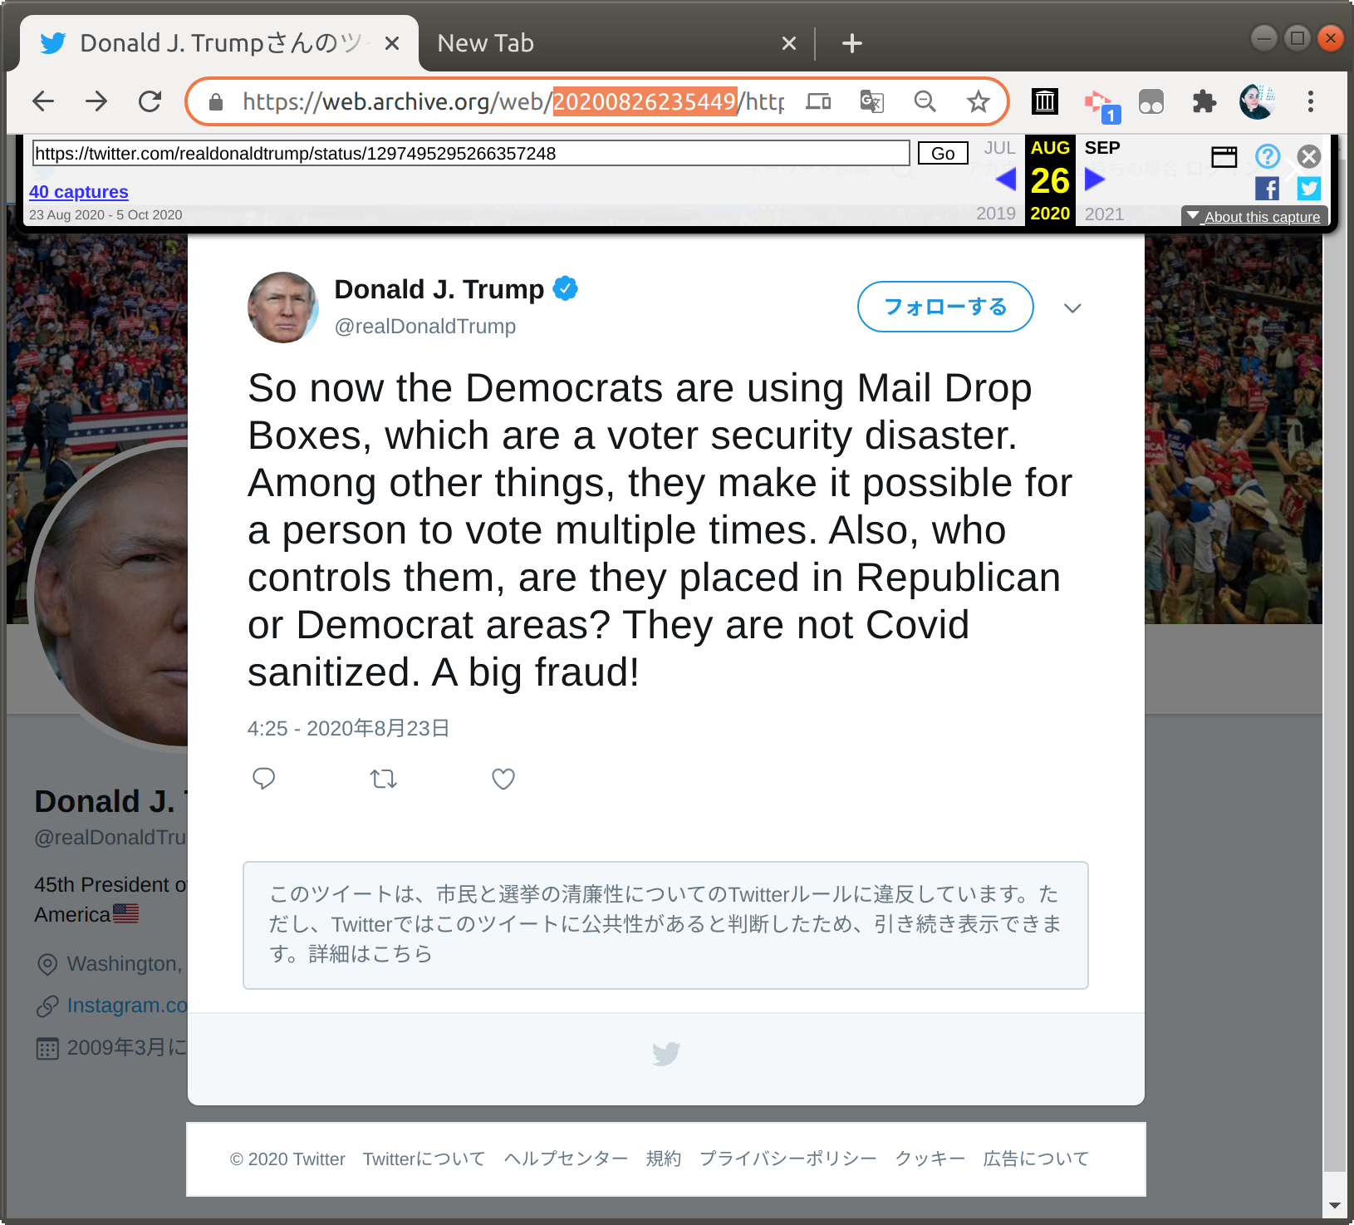
Twitter has added label to old UI mementos as well.
The earliest old UI memento with label I could find is from Aug 26, 2020.
@kritika_garg (kgarg001@odu.edu) CS895 Web Archiving Forensics, Fall 2020

Slide 9
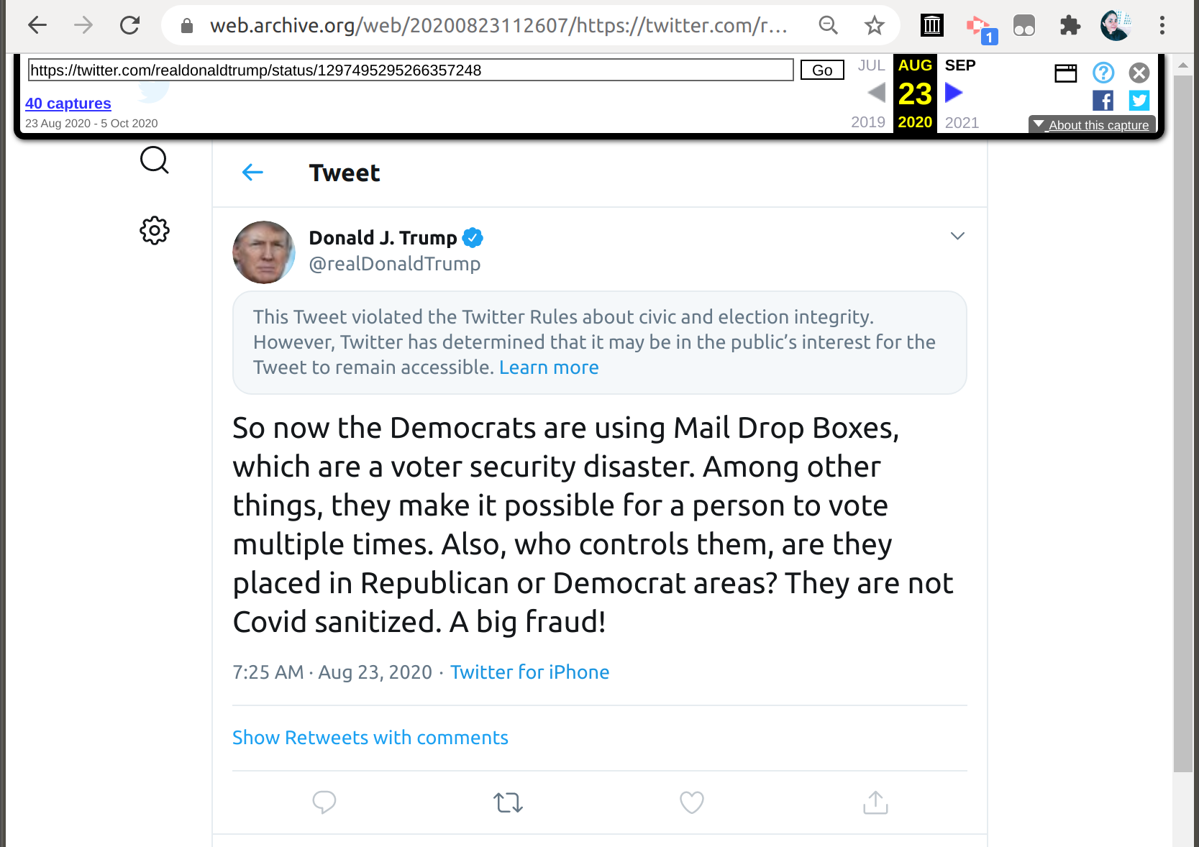
New UI mementos in IA can be deceiving
Original tweet created at :
2020-08-23T11:25:59Z
According to this memento the tweet was labeled within 1 min and 8 secs.
@kritika_garg (kgarg001@odu.edu) CS895 Web Archiving Forensics, Fall 2020

Slide 10
Temporal Violation in new UI mementos in IA
Original tweet created at : 08-23-2020 11:25:59
According to this memento the tweet was labeled within 1 min and 8 secs.
+9 Hours
@kritika_garg (kgarg001@odu.edu) CS895 Web Archiving Forensics, Fall 2020

Slide 11
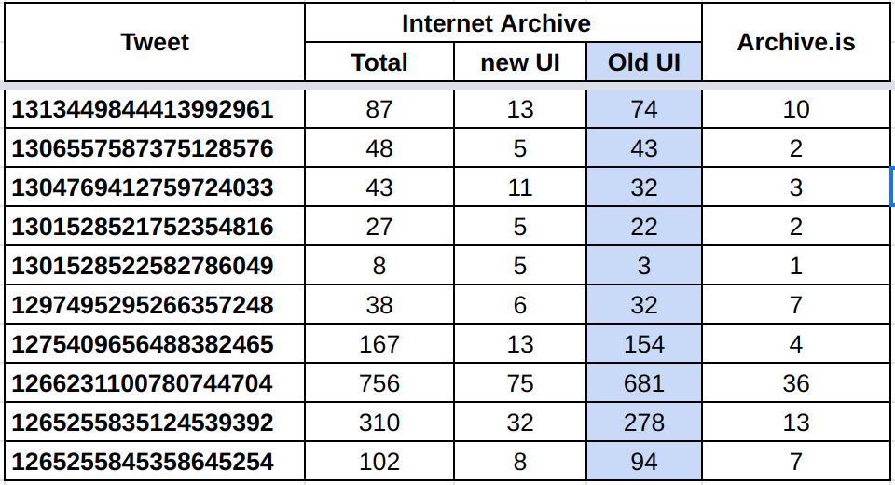
Distribution of old and new UI mementos in IA.
Table 1. The number of old UI and new UI mementos in IA for the 10 labeled tweets.
Data is tabulated using Memgator & CDX API on 2020-10-14T21:45.
https://github.com/oduwsdl/MemGator,
https://github.com/internetarchive/wayback/blob/master/wayback-cdx-server/README.md
@kritika_garg (kgarg001@odu.edu) CS895 Web Archiving Forensics, Fall 2020

Slide 12
It takes an average of 4-5 hours for Twitter to label Trump's tweets
Violated Rules label -> Only Quote Tweets are allowed
Tweet gets likes, retweets, replies
T₁
T₂
Tweet created by
@realDonaldTrump
Tweet labeled by Twitter in 4-5 hours (On average)
Timeline of the labeled tweets
@kritika_garg (kgarg001@odu.edu) CS895 Web Archiving Forensics, Fall 2020

Slide 13
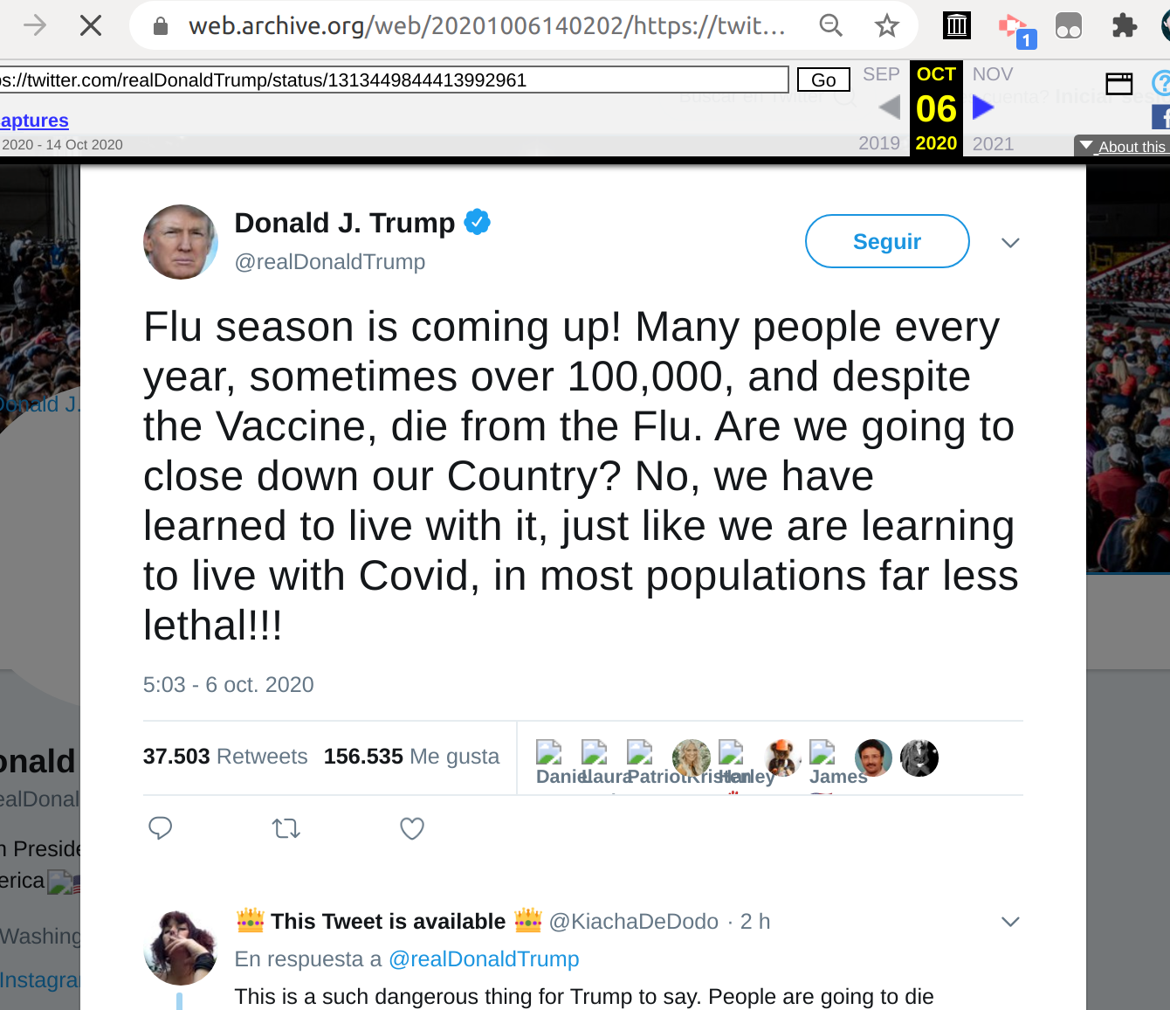
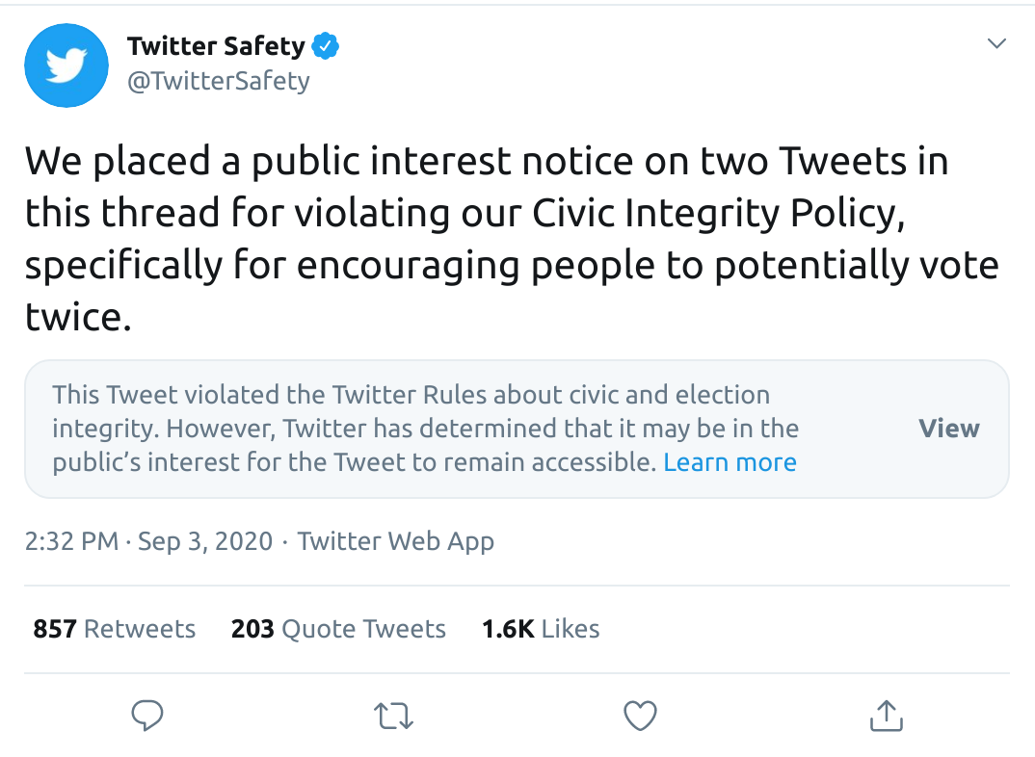
Tweets engagements before label
Scraped mementos with old Twitter UI to collect engagements.
3 out of 7 tweets labeled for violation, did not had any old UI mementos with engagements
The label time(T2) is found using the first old UI memento with label or with help of Twitter’s announcement about the labeled Tweet.

Slide 14
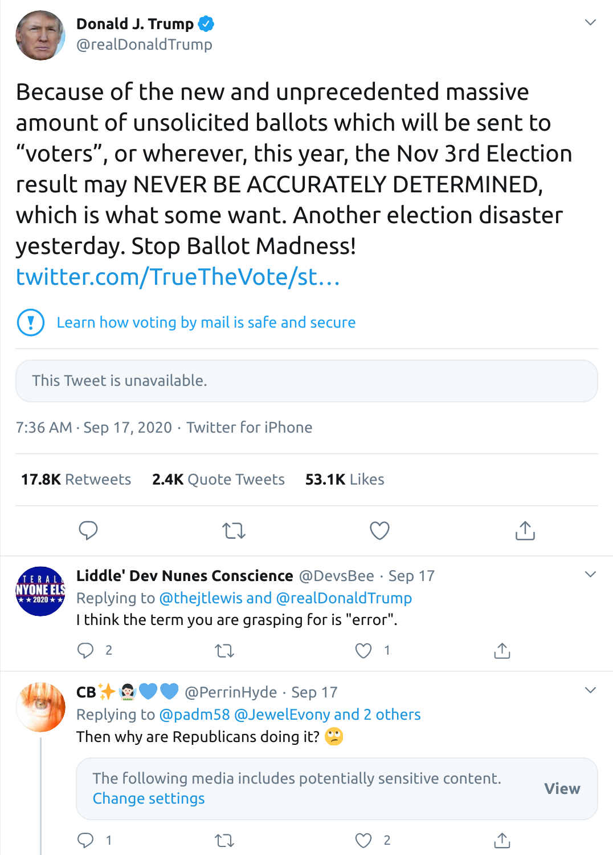
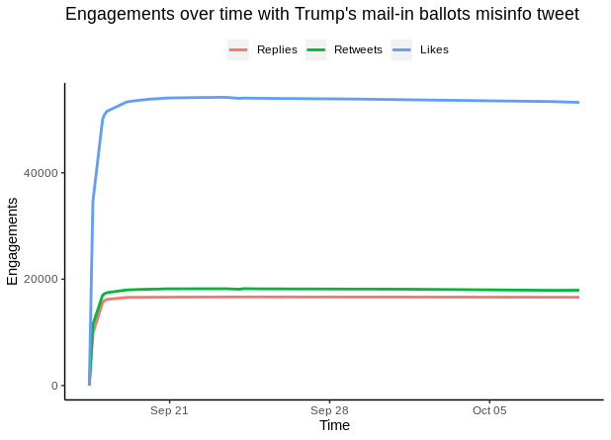
Engagements with Trump’s potential misleading Tweet regarding mail-in ballots
Tweeted at:
2020-09-17 11:36:18 UTC
Labeled no later than: 2020-09-17 15:31:00 UTC
https://twitter.com/realDonaldTrump/status/1306557587375128576
@kritika_garg (kgarg001@odu.edu) CS895 Web Archiving Forensics, Fall 2020

Slide 15
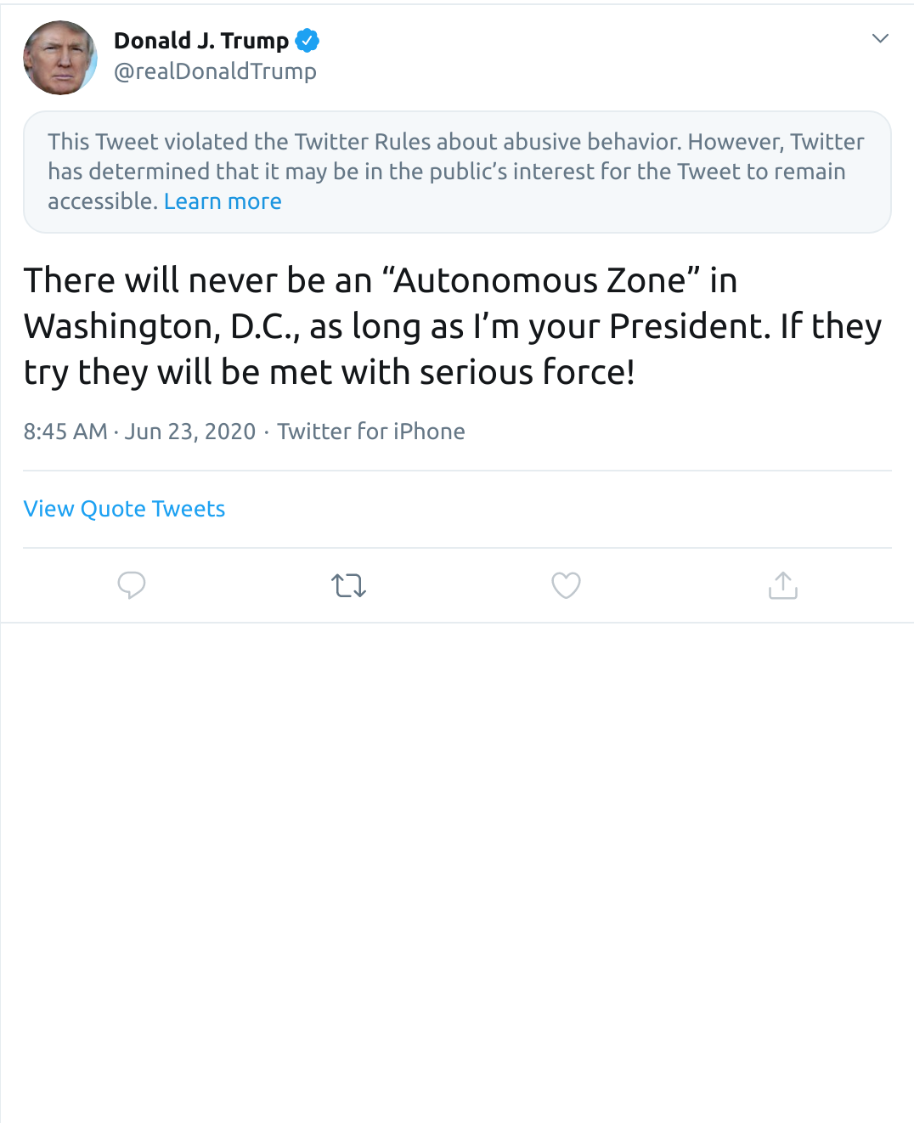
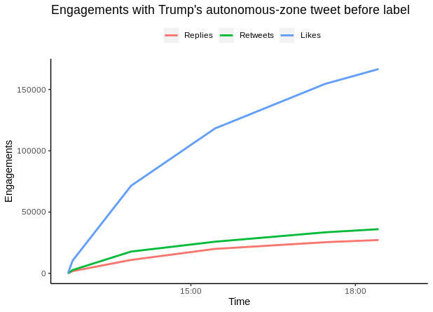
Engagements with Trump’s “Autonomous-zone” tweet using old UI mementos
https://twitter.com/realDonaldTrump/status/1275409656488382465
Tweeted at:
2020-06-23 12:45:32 UTC
Labeled no later than:
2020-06-23 18:46:00 UTC
@kritika_garg (kgarg001@odu.edu) CS895 Web Archiving Forensics, Fall 2020
Notes:
this is where we'll need the list of URI-Ms corresponding to each of the 10 URI-Rs

Slide 16
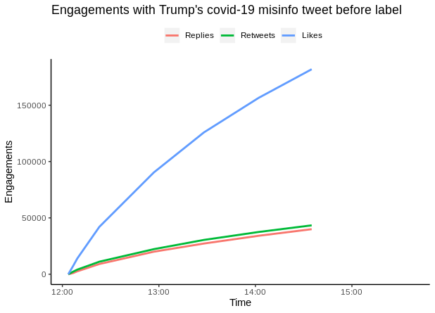
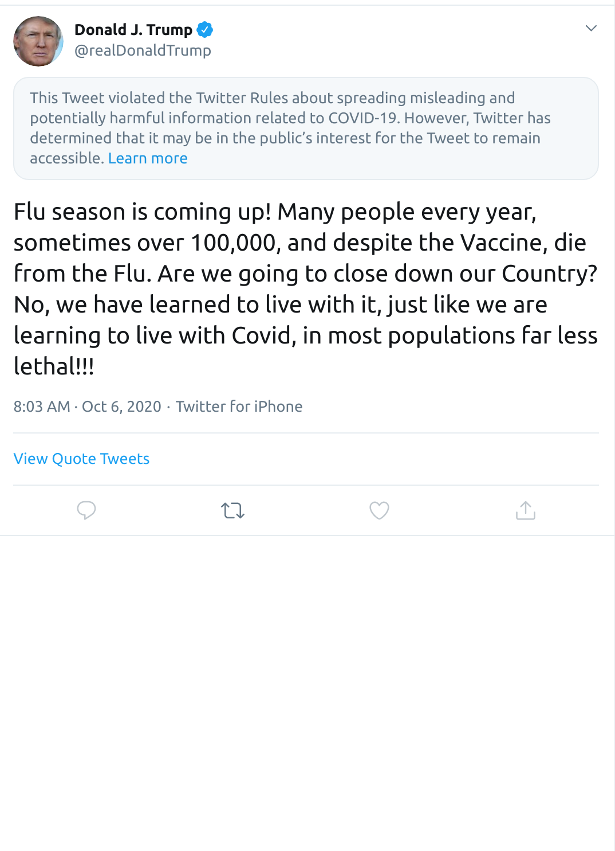
Extracted engagements from old UI mementos
https://twitter.com/realDonaldTrump/status/1313449844413992961
Tweeted at:
2020-10-06 12:03:40 UTC
Labeled no later than:
2020-10-06 15:37:45 UTC
@kritika_garg (kgarg001@odu.edu) CS895 Web Archiving Forensics, Fall 2020

Slide 17
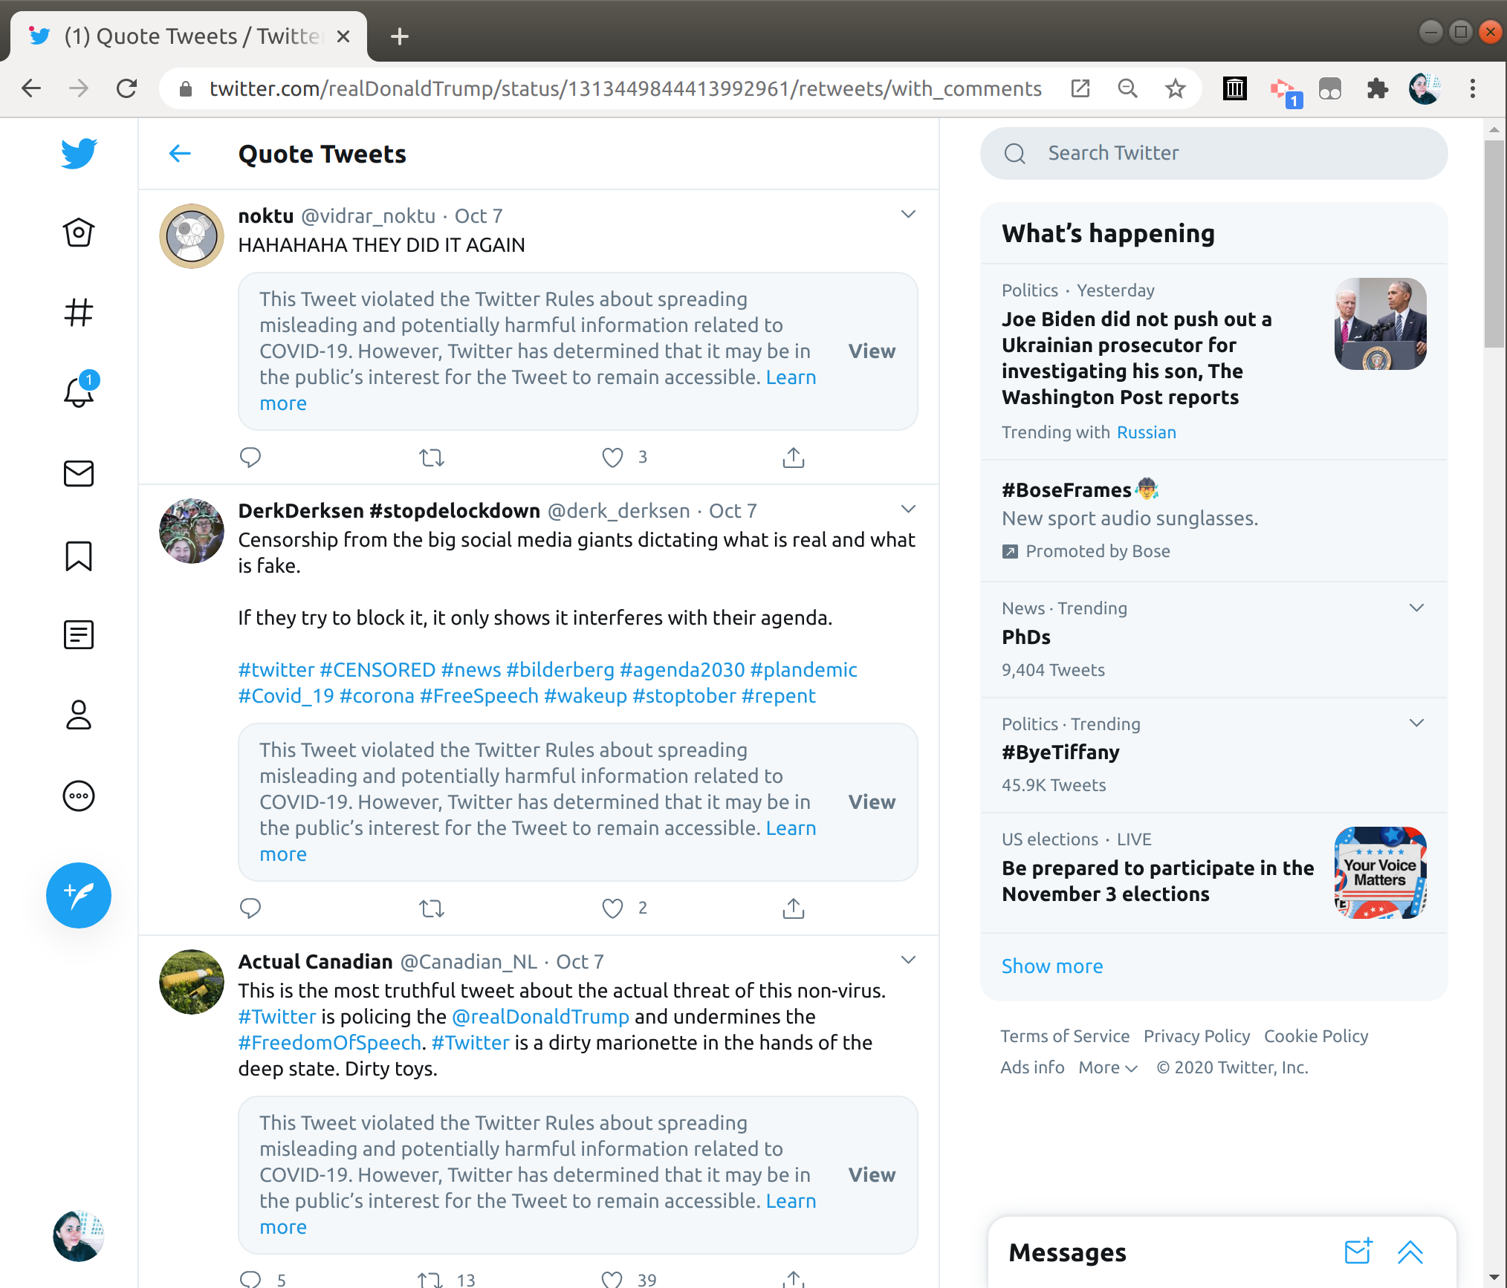
Engagement with quote tweets
Scraped quote tweets page using Chrome dev console.
Extracted tweets using Haralyzer.
Used JQ to extract the user count and user details from the tweets.
https://pypi.org/project/haralyzer/
https://stedolan.github.io/jq/
https://twitter.com/realDonaldTrump/status/1313449844413992961/retweets/with_comments
@kritika_garg (kgarg001@odu.edu) CS895 Web Archiving Forensics, Fall 2020

Slide 18
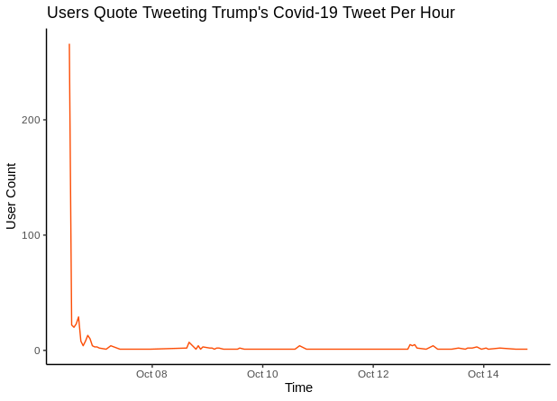
Approx 60% of Quote Tweets (517) were tweeted before the label.
@kritika_garg (kgarg001@odu.edu) CS895 Web Archiving Forensics, Fall 2020

Slide 19
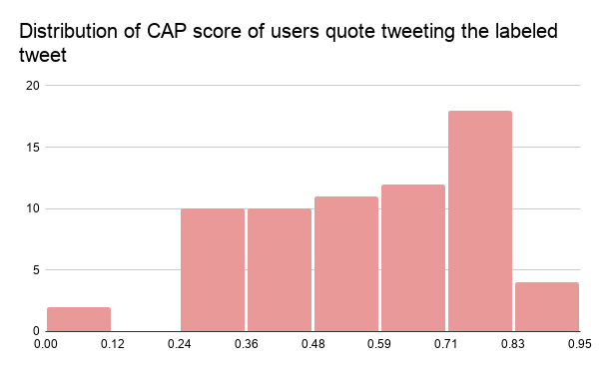
High probability of bot quote tweeting the Trump’s labeled Covid-19 tweet
The distribution of Botometer Complete Automation Probability (CAP) score
https://botometer.osome.iu.edu/
@kritika_garg (kgarg001@odu.edu) CS895 Web Archiving Forensics, Fall 2020

Slide 20
Summary
Collected 10 of President Trump’s tweets labeled by Twitter.
The mementos of these tweets can be found in IA, archive.is and perma.cc. These tweets are mostly archived in IA’s Wayback Machine.
The new UI mementos in IA are subject to temporal violations.
On Average, Twitter labeled the Trump tweet within 4-5 hours.
The engagements with the tweet showed a similar pattern. Likes increase drastically. Retweets are more than replies.
60% of quote Tweets collected of Trump’s covid-19 tweet were tweeted before the label.
There is a higher probability that bot accounts are quote tweeting the covid-19 tweet.

